Slide 1
ESSENTIAL GEOSYSTEMS
Week 1

Slide 2
Outline
Earth Systems Concepts
Systems Organization
Earth’s Dimensions
Earth’s Rotation
Location on Earth
Maps, Scale, and Projections
Geographic Information Science/System
Remote sensing and contemporary GIS data

Slide 3
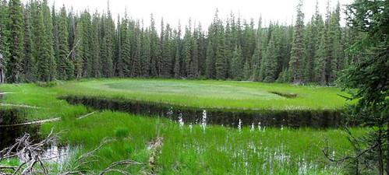
Earth Systems Concepts
System: any distinct set of ordered, interrelated components and their attributes, linked by flows of energy and matter.
Notes:
Beaver Skull Fen in West Elk Wilderness in Colorado – picture from: https://www.usda.gov/media/blog/2014/07/15/rocky-mountain-wetland-provides-fen-tastic-habitat-high-altitude-plants

Slide 4
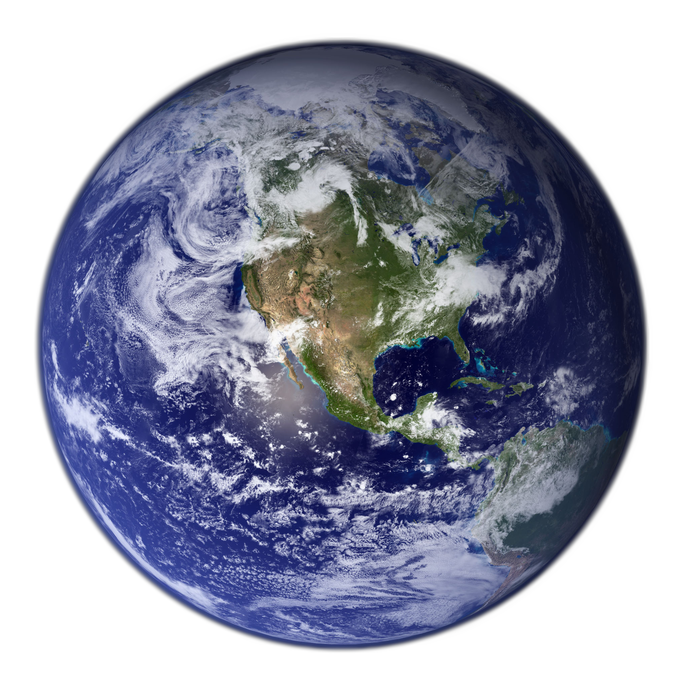
Earth Systems Concepts
Open system = inputs and outputs of matter and energy flow freely to and from the system
Closed System: one that is shut off from the surrounding environment (i.e. self-containment)
Is Earth a closed or open system?
Why is it important to recognize this?

Slide 5
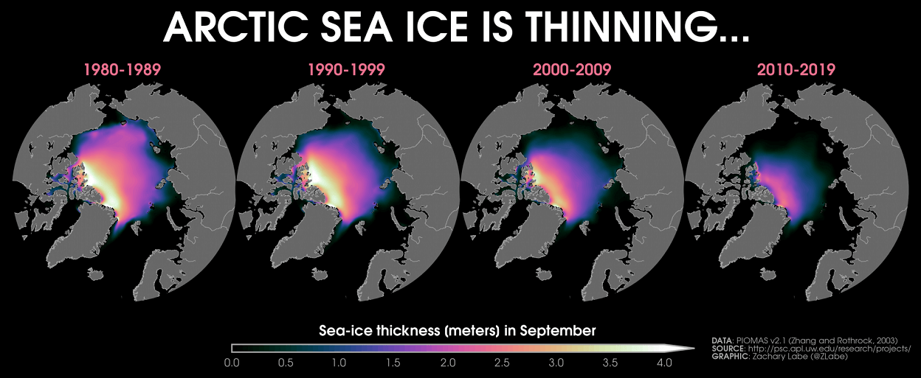
Earth Systems Concepts
An operating system creates outputs that impact its own operations
Positive feedbacks encourage further operation and change, negative feedbacks discourage change in the system.

Slide 6
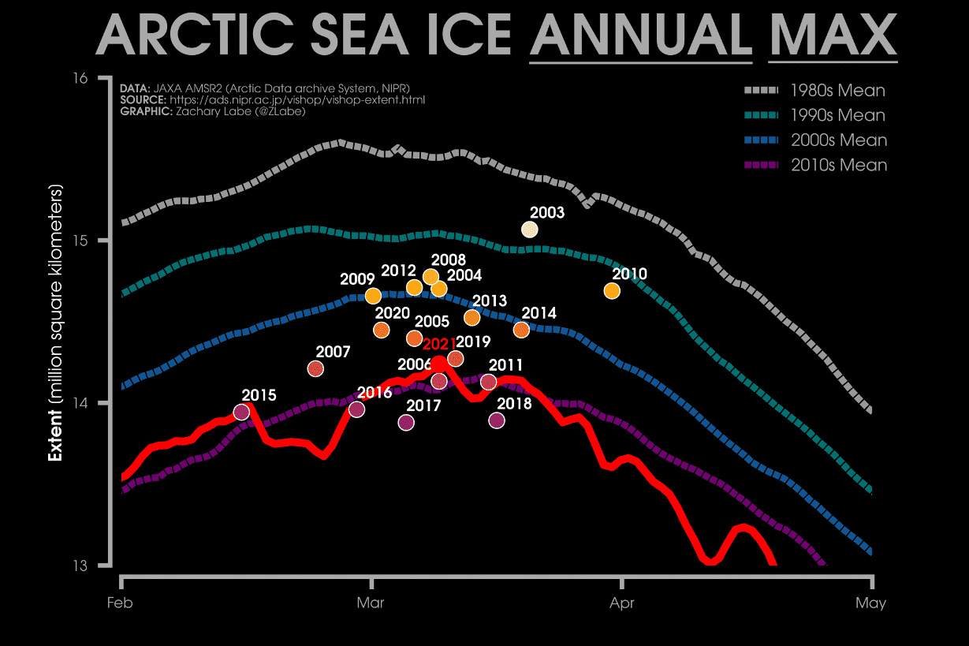
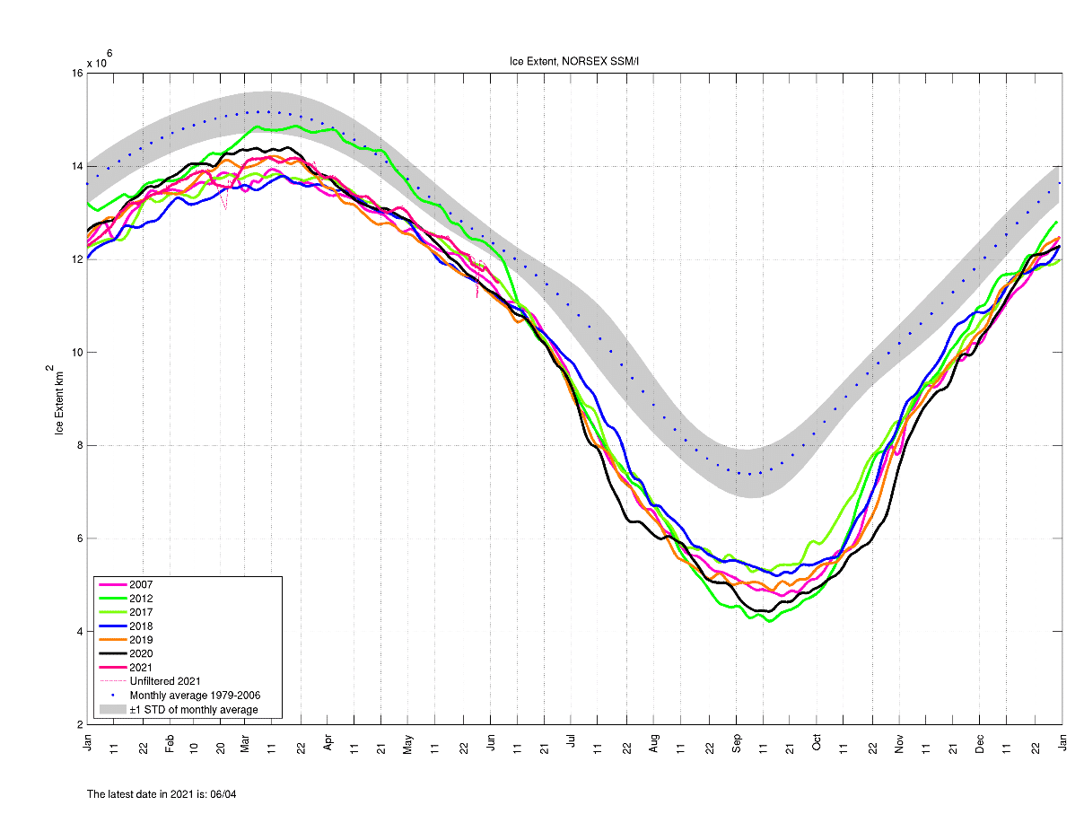
Earth Systems Concepts

Slide 7
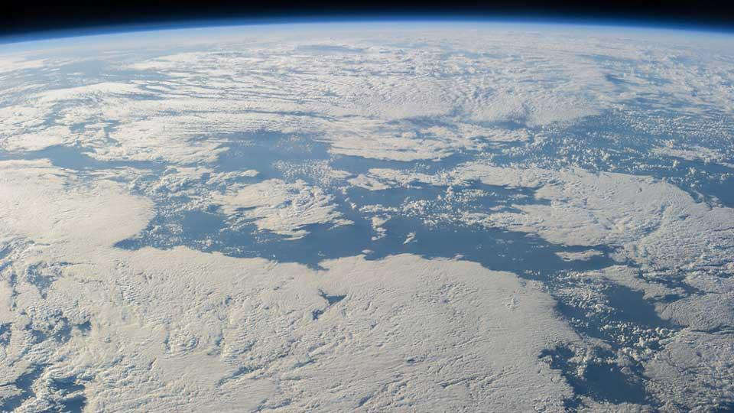
Earth Systems Concepts
Warmer air > more moisture in the air > more to form clouds > thicker clouds > less sunlight > cooler air.

Slide 8
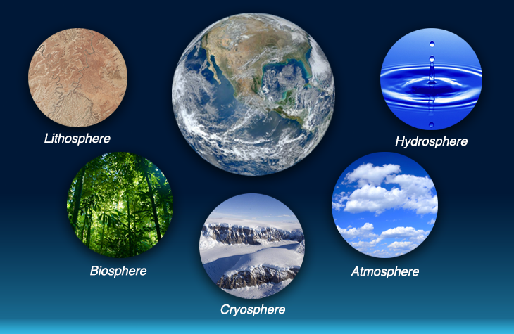
Earth’s Spheres

Slide 9
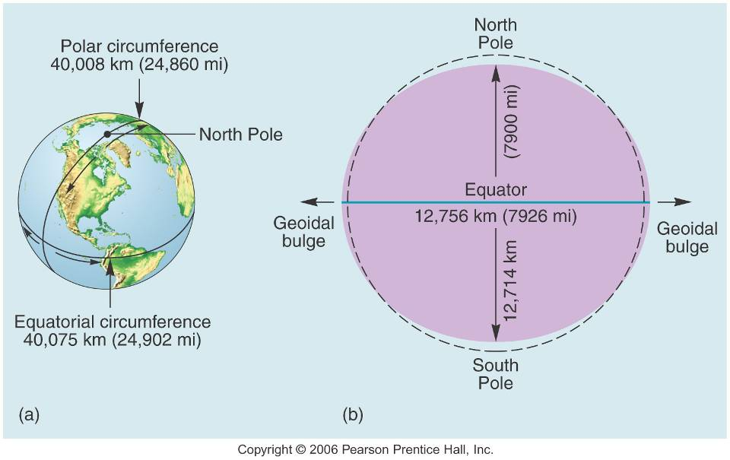
Earth’s Dimensions
The formal term for the shape of the Earth is: Oblate Spheroid

Slide 10
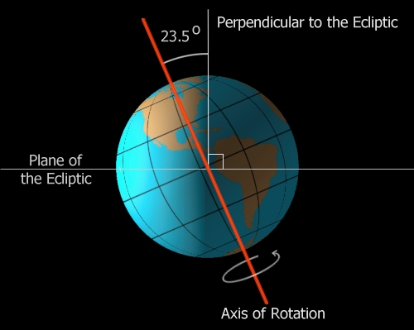
Earth’s Rotation
Solar Day – One complete rotation of the earth (approx. 24 hrs.)
Earth “spins”, or rotates on its axis
The Earth’s tilt is 23.5°

Slide 11
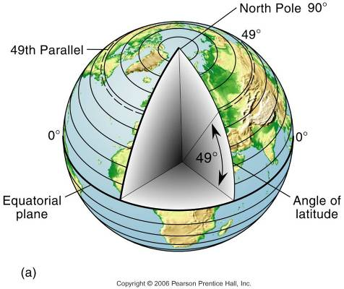
Location on Earth
Latitude
Divides Earth into hemispheres
Parallels = lines connecting all points along the same latitudinal angle
Measured north and south of the primary or base line of latitude known as the equator

Slide 12
Location on Earth
Latitude
Major lines of latitude (e.g., equator, tropic of cancer) are derived naturally based on Earth-Sun geometry (Chp 2), specifically sun angles and day length.
We will cover E-S next week.

Slide 13
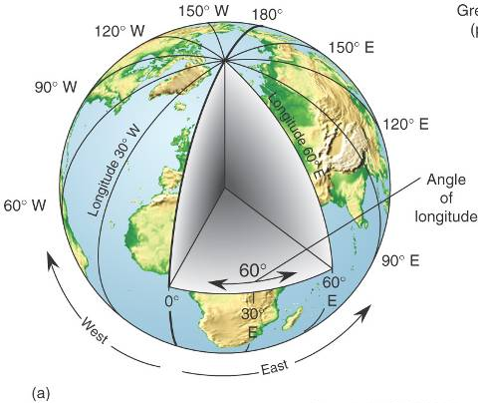
Location on Earth
Longitude
Divides the Earth in half
Meridians = lines connecting all points along the same longitude
Meridians measure east and west of the primary line of longitude known as the Prime Meridian

Slide 14
Location on Earth
Longitude
The two major lines of longitude, the Prime Meridian and International Date Line, are politically derived.
The PM runs through the Royal Observatory in Greenwich.

Slide 15
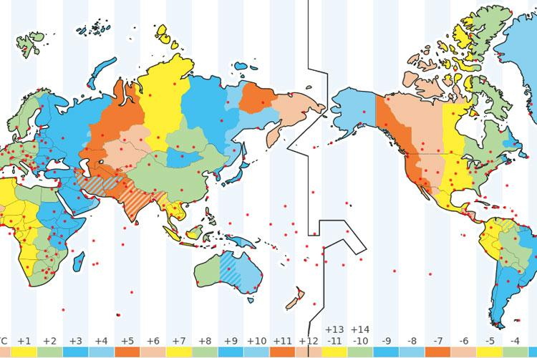
International date line
The 180 degree longitude line
No direction notation (just like equator)
Notes:
Wikipedia + Rashid’s Blogpost – various versions of this image exist, Google “international date line” for more versions.

Slide 16
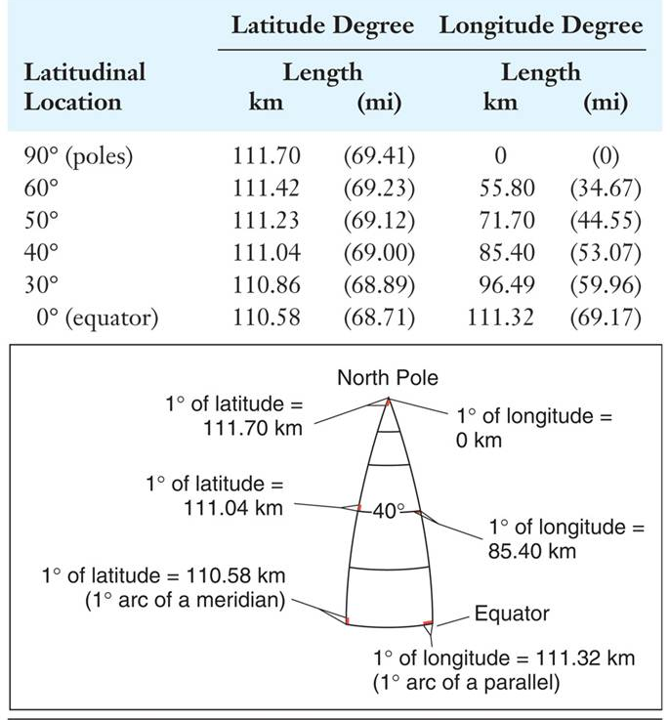
Location on Earth
Distances between parallels do not change away from the equator
Distances between meridians do change away from the equator

Slide 17
Locations on Earth
Every location has a latitude and longitude coordinate
Locations can be listed using decimal or temporal notation
E.g: 25.6 deg N, 78.8 deg E
E.g: 12 deg 7’ 27”S, 94 deg 18’ 19” W
Notation follows degrees, minutes, seconds
60 minutes per degree, 60 seconds per minute

Slide 18
DIGGING DEEPER
Optional at home activity!
Research the history of longitude. Why do we use time to denote distance??
Start your google search here: “Longitude by Dava Sobel”
Reflect -- How do primary lines of latitude and longitude differ? How does this explain why there isn’t a book called Latitude?

Slide 19
Maps, Scale, and Projections
Maps = a generalized view of an area as seen from above and greatly reduced in size.
Maps are tools for spatial analysis
http://hint.fm/wind/

Slide 20
Another example of a wind map…
https://earth.nullschool.net/
What do you notice that’s different about this geovisualization?
How does this difference change the use? The message? The audience?

Slide 21
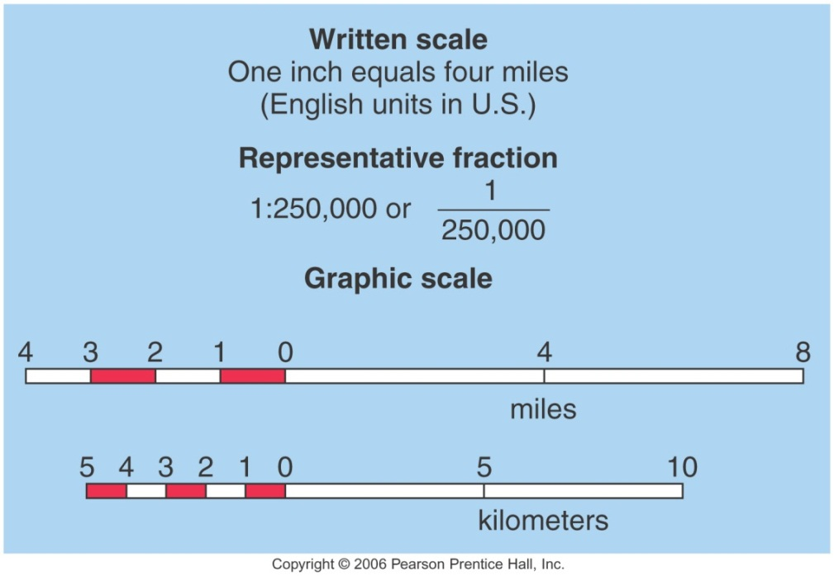
Maps, Scale, and Projections
Scale = the ratio of the image on the map as compared to the real world.
One of the 3 is different from the others. Which one? In what way?

Slide 22
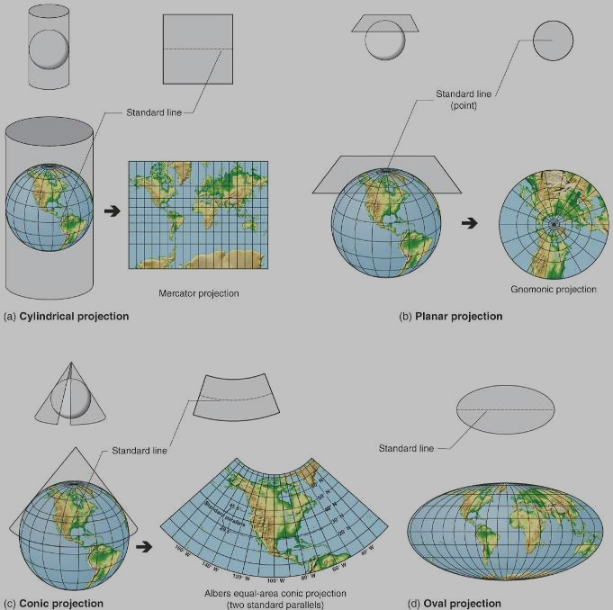
Maps, Scale, and Projection
Map Projection is the reduction of the spherical Earth to a flat surface

Slide 23
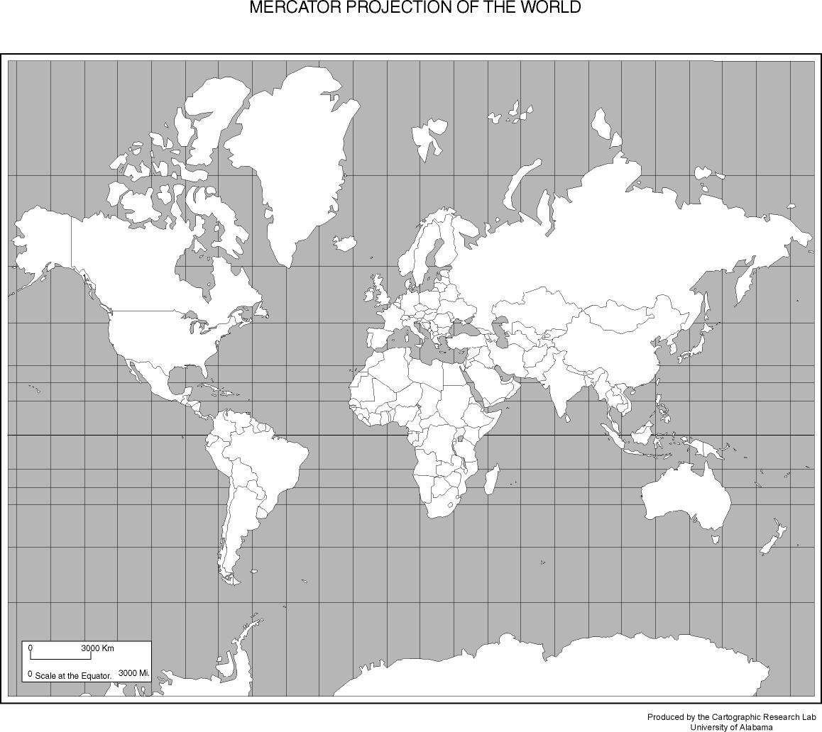
Distortion in Maps
A
B

Slide 24
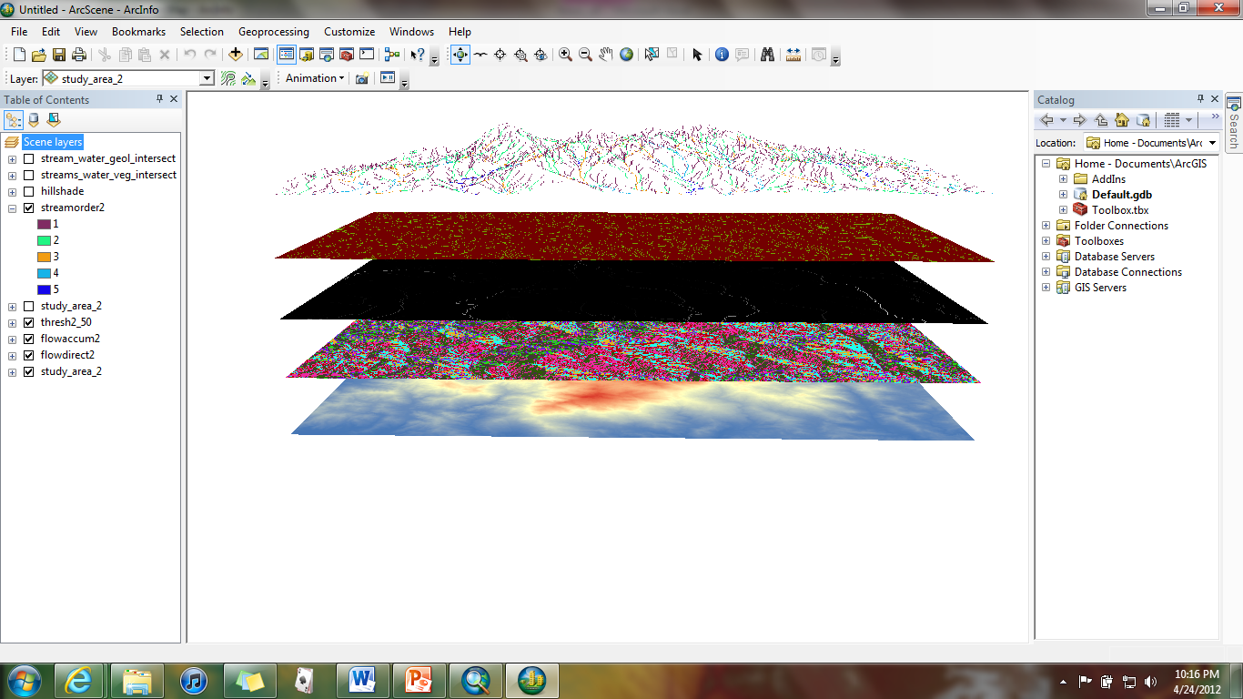
What is GIS?
GIS stands for either Geographic Information System(s) or Geographic Information Science depending on the usage
A “system” can be thought of as a spatial model used to portray something about the Earth or reality
The “Science” is the discipline of studying spatial analysis using GISystems

Slide 25
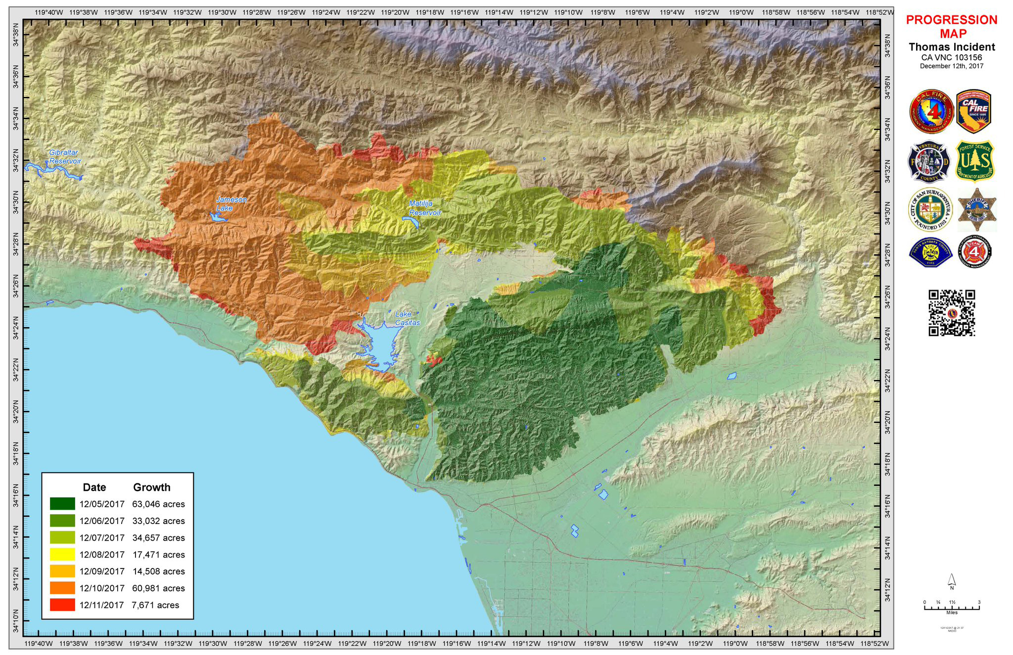
GISystems are powerful tools that can be used to analyze and display various types of multi-dimensional data at once. What is the map below telling you?

Slide 26
So what can we do with GIS?
Common career paths right now that depend on GIS – department of transportation, land and resource management, economic geologists, city and regional planning, natural hazard and emergency managers, ecosystems analyst, climate modelers, environmental engineers, archaeologists, stream ecologists, biogeographers, wildland fire scientists, and many many more!

Slide 27
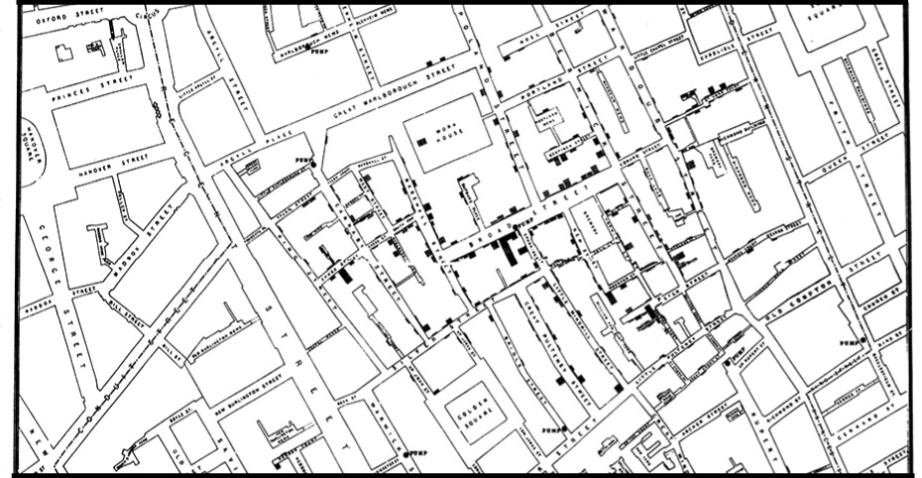
The Power of GIS
John Snow’s 1854 Cholera Map

Slide 28
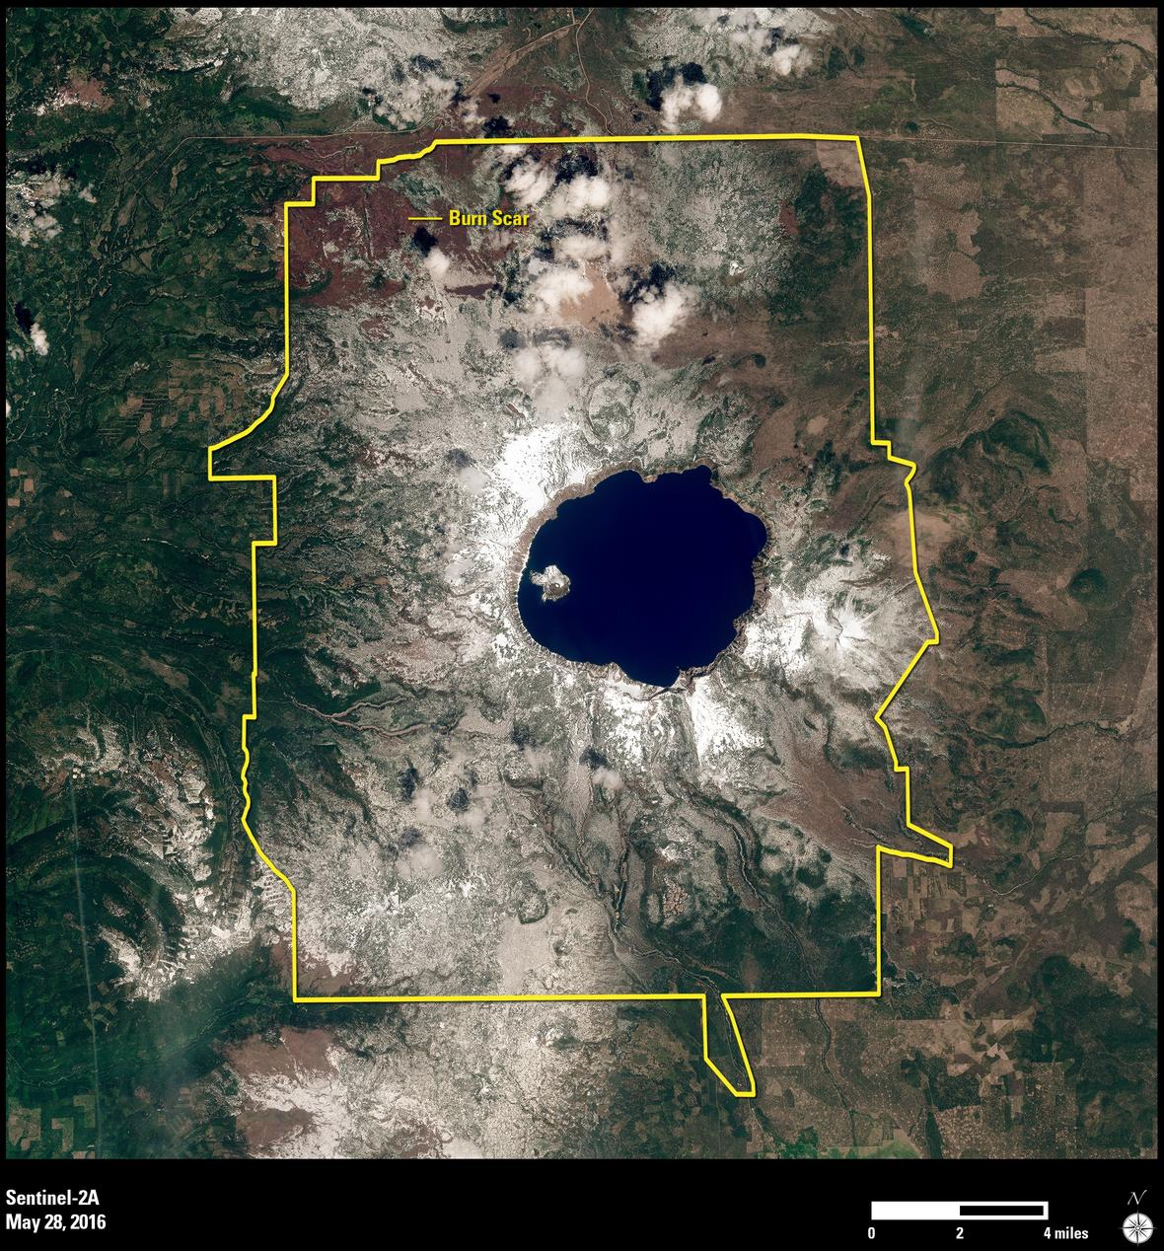
Remote Sensing and Contemporary GIS
Remotely sensed data are those collected away from their observation
Satellites offer a wealth of data beyond the visible light spectrum
Increasingly fine spatial resolution allows for truly rich imagery and data.

Slide 29
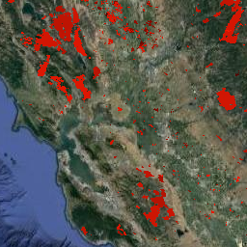
Remote Sensing and Contemporary GIS
Moderate Resolution Imaging Spectroradiometer (MODIS): https://modis.gsfc.nasa.gov/
Derived land product for 500m resolution Monthly Burned Area gives data back to 2000.

Slide 30
Remote Sensing and Contemporary GIS
Further Learning – check it out on Google Earth Engine here: https://developers.google.com/earth-engine/datasets/catalog/MODIS_006_MCD64A1
Want the Java code to play with this on your own? Don’t hesitate to ask and I’ll email you my split panel code to get cracking! ☺

Slide 31
More GIS courses?
Interested in GIS? Remote sensing?
Many courses are taught each term by a suite of faculty in the Geoscience dept!
Topics include: geostatistics, critical cartography, fire mapping, remote sensing, GIS programming, Web-based GIS, and much more!

Slide 32
Looking Ahead
Next week we begin Chp. 2 in your textbook
Lecture topics will begin to explore concepts of earth-sun geometry and our layered atmosphere
Lab #2 is next week!

